Slide 1
Fantasy Football
Trent Florey, Jacob Duell, Caitlin Iadonisi, Jake Notowich, Parker Sherrill

Slide 2
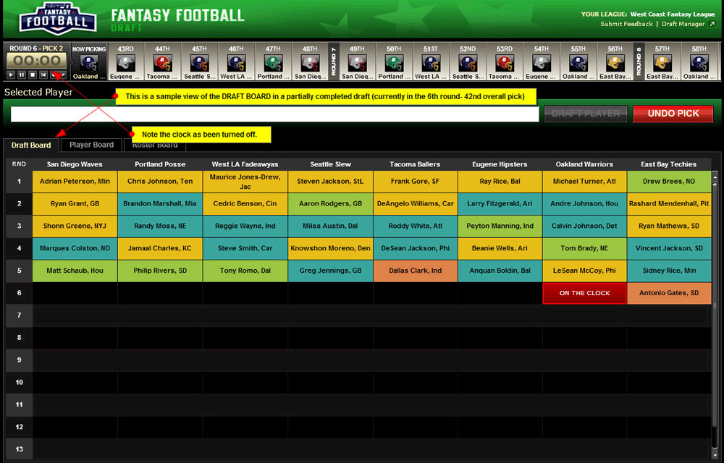
What problem are we trying to solve?
Eliminate the guesswork from fantasy football draft strategies
Determine a value for players relative to other positions.
Our algorithmic model will help predict potential fantasy output for the entire season, and relative player value

Slide 3
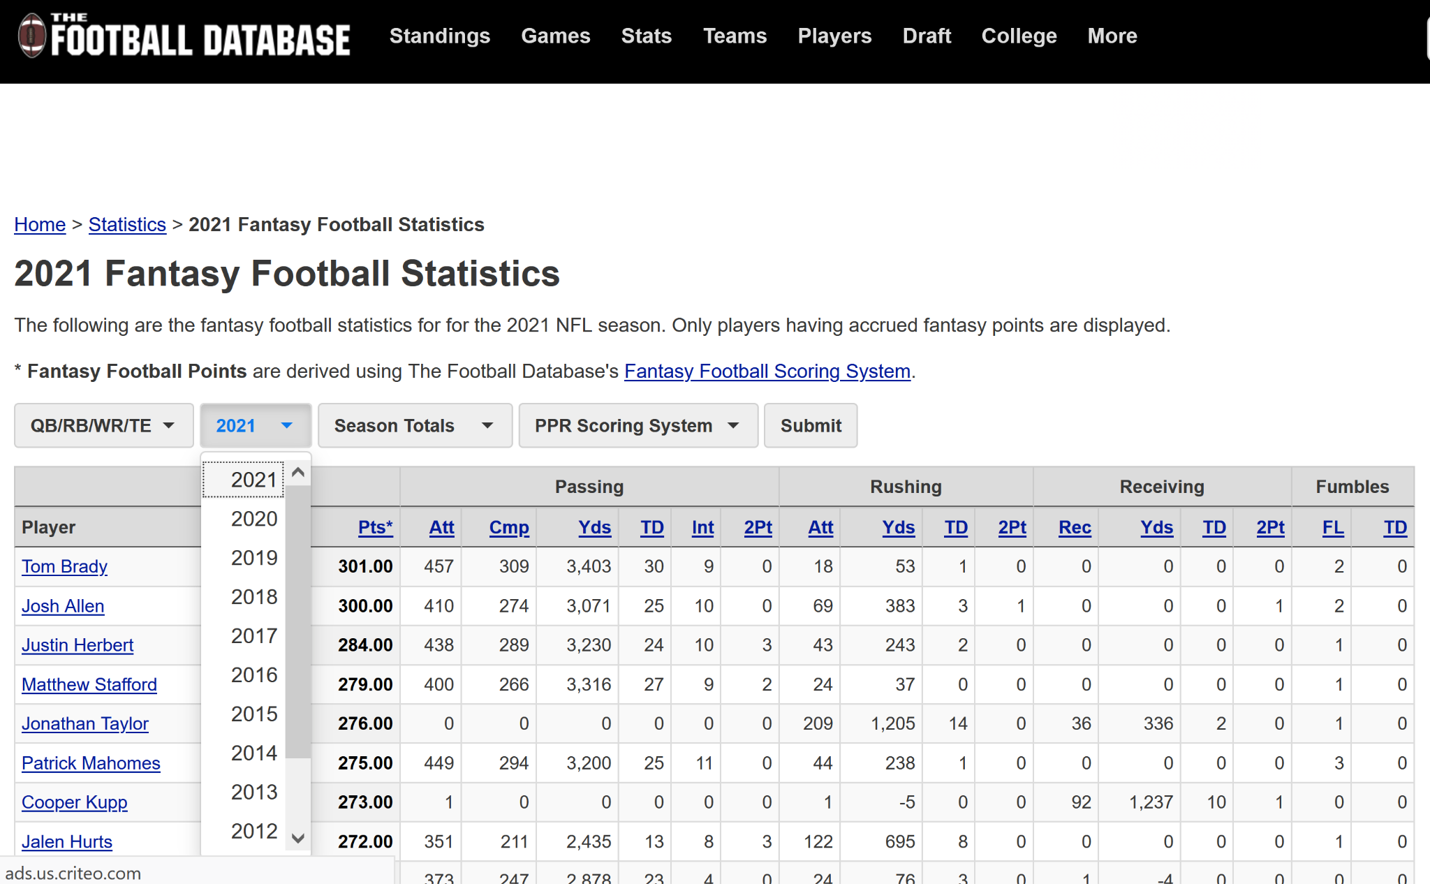
Retrieving Data
We gathered data by web scraping from The Football Database website regarding the past 10 fantasy seasons. Looking at the points scored by each position over this era yields a trend in positional value that users can utilize in order to make knowledgeable plays throughout the season.
Notes:
Web scraping - extracting data from websites

Slide 4
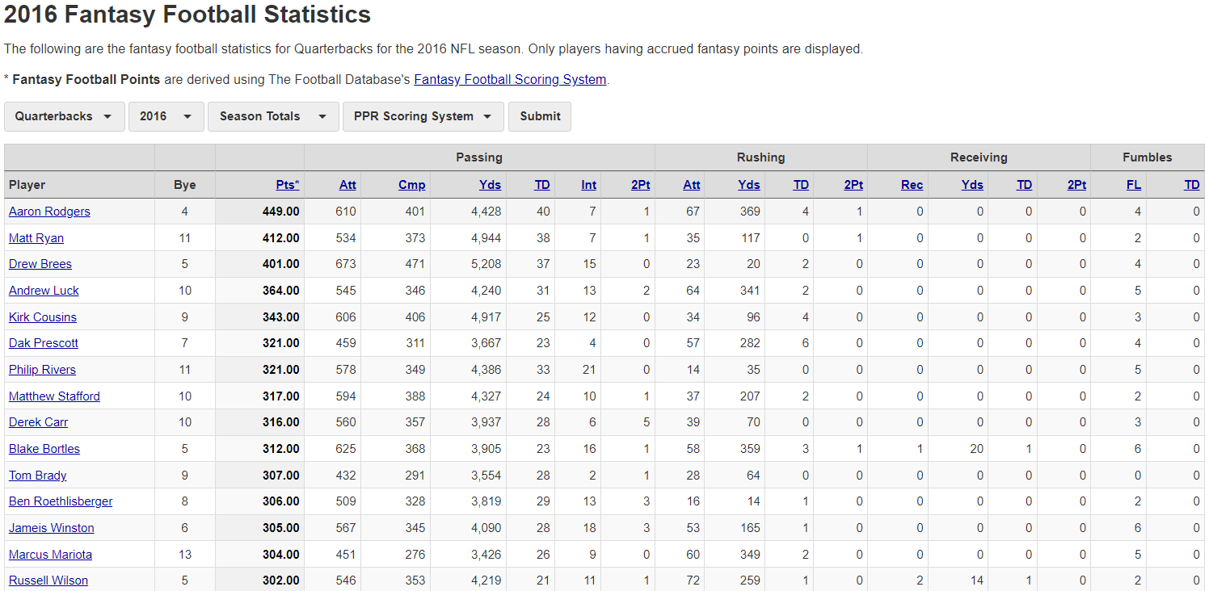

Slide 5
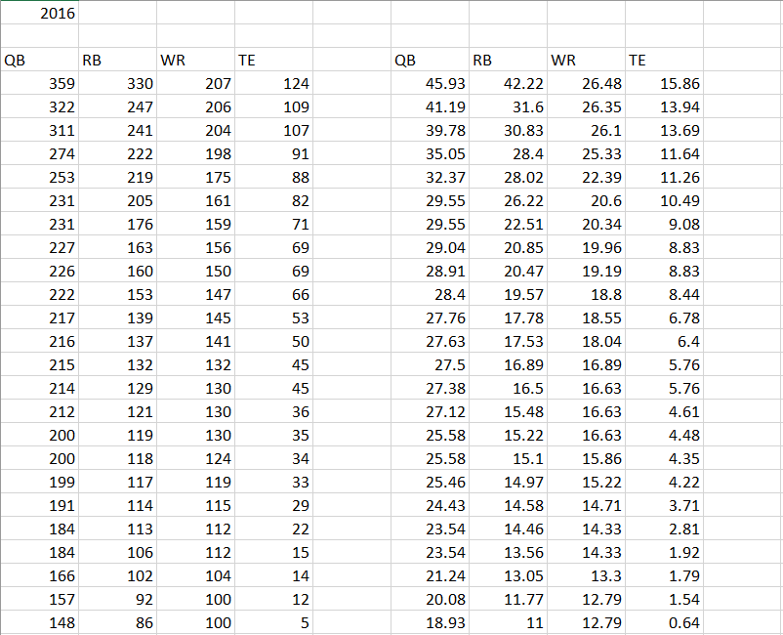
Performing the Analysis
Upon analysis, we discovered that QBs, and RBs are worth the most on average over the last 10 football seasons. Followed by WR and TEs. Interestingly, WRs are grouped closer, so a 10-15 WR might be better than a 10-15 RB even though a top RB tends to be worth much more.
(below: POR followed by value in $)
We have developed a Replacement Value Algorithm to determine the relative value of each positional player

Slide 6
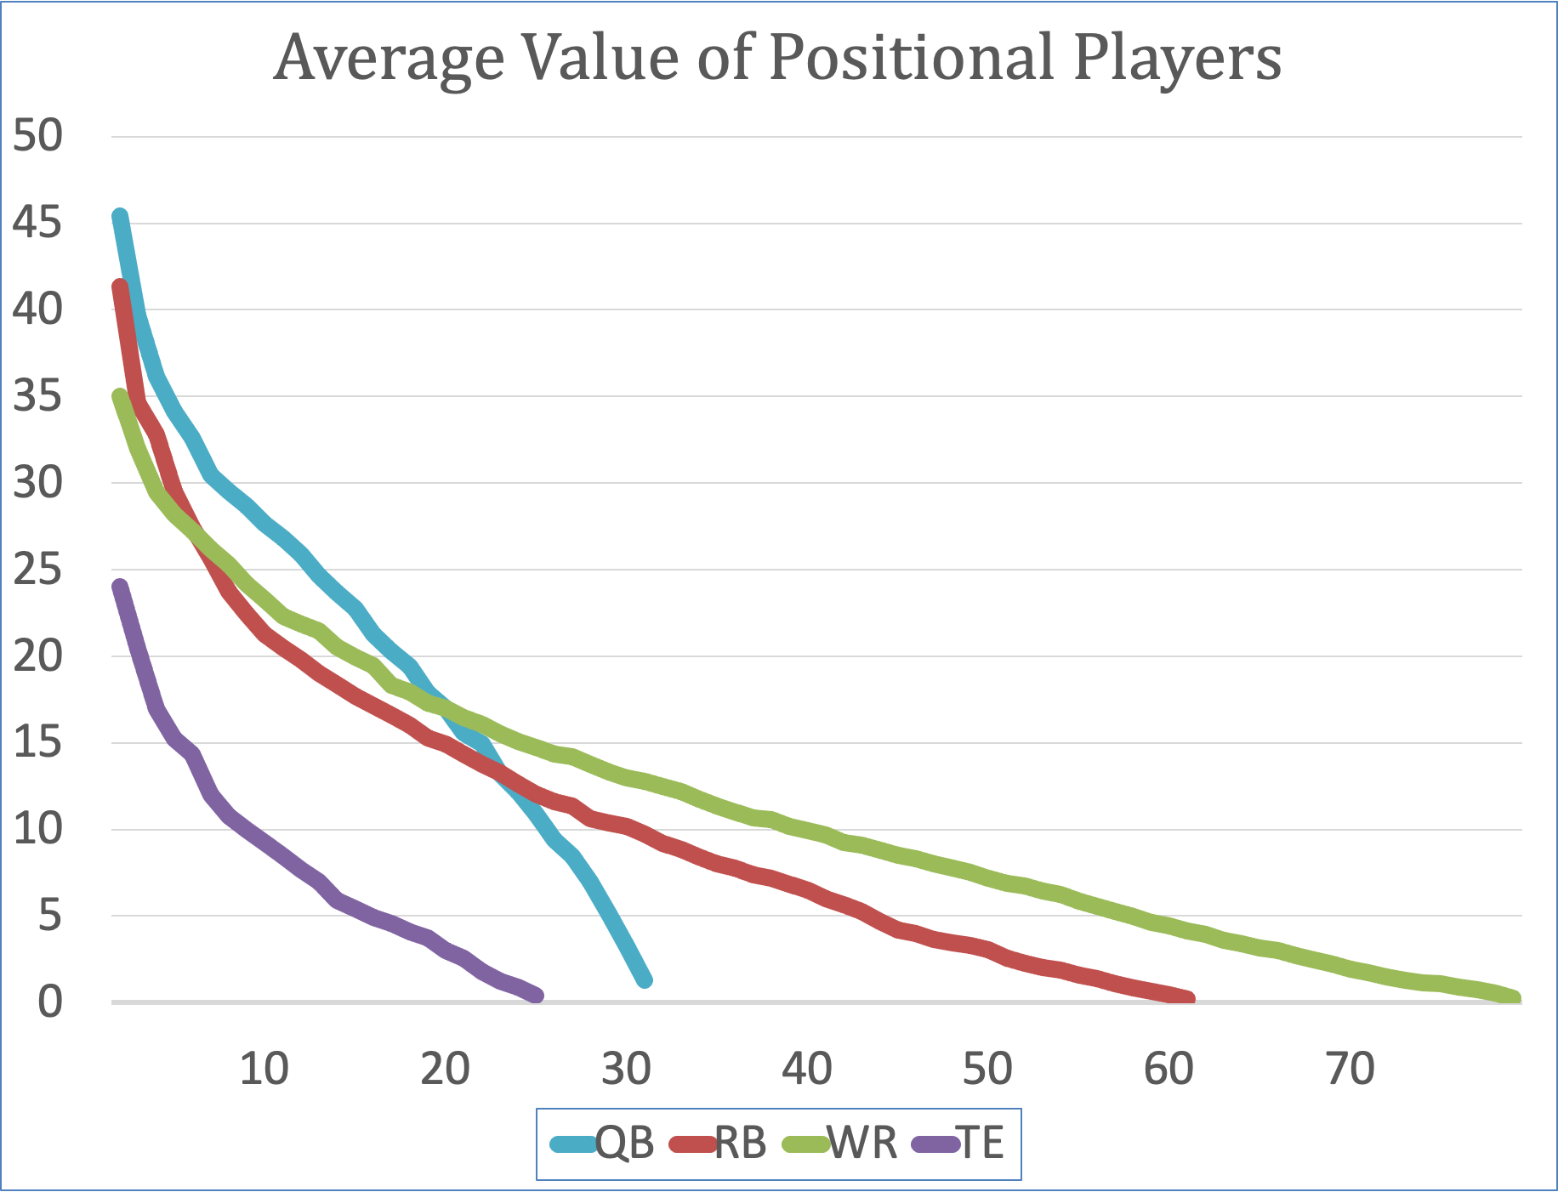
Outcome
We have determined the value of the rankings in regards to each position. Here are our value charts for rankings with position groups.

Slide 7
How Our Algorithm Applies to Users
Questions answered by our algorithm:
Which position should I draft in the first round of a fantasy football draft?
How do players in fantasy football acquire points?
Is the difference between a 1 ranked tight end and a 5 ranked tight end linear, exponential, or neither?
How much more valuable is the top running back compared to the top tight end or quarterback?
Is there a difference in the value of these positions?

Slide 8
Questions?

